Slide 1





Studying the brain: what, why and how?
Aamir Sohail
PhD student in Psychology
University of Birmingham

Slide 2






BSc
Biomedical Science
MSc
Brain Imaging
PhD
Psychology

Slide 3
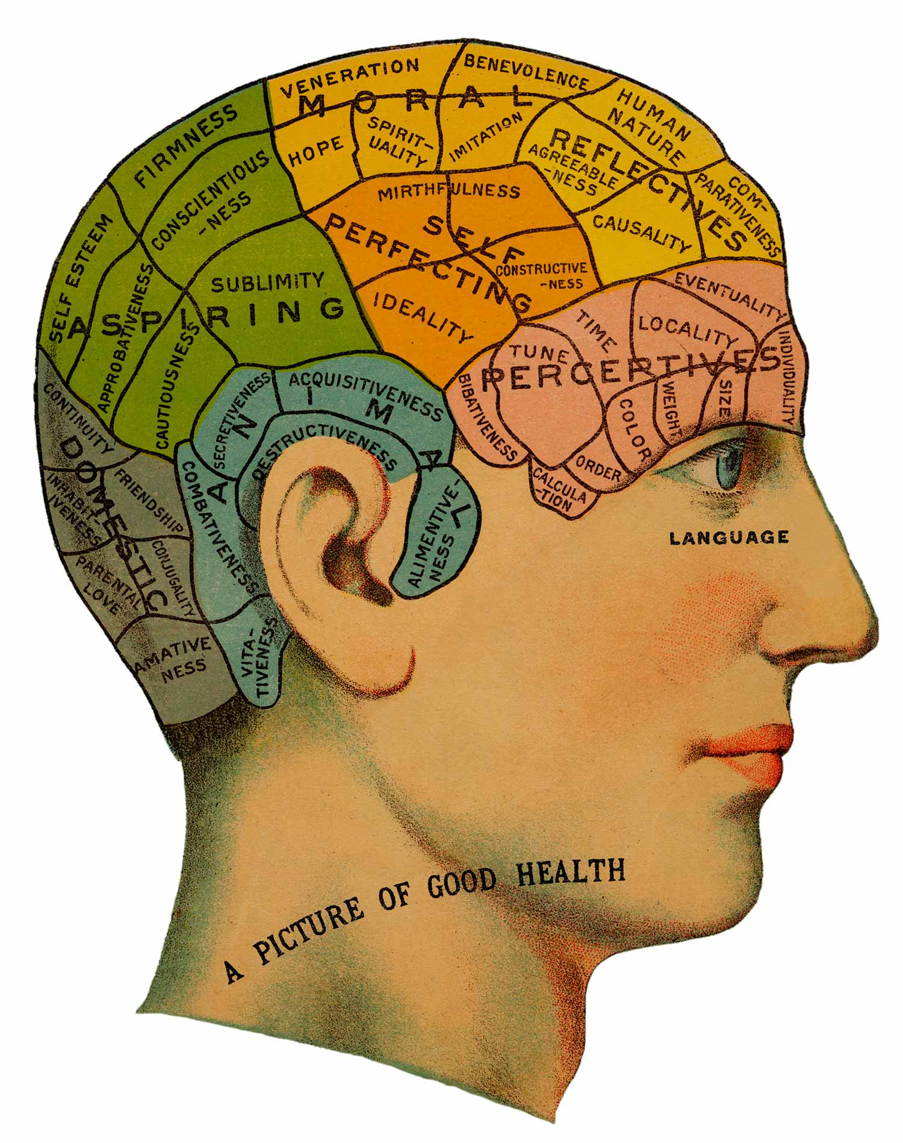

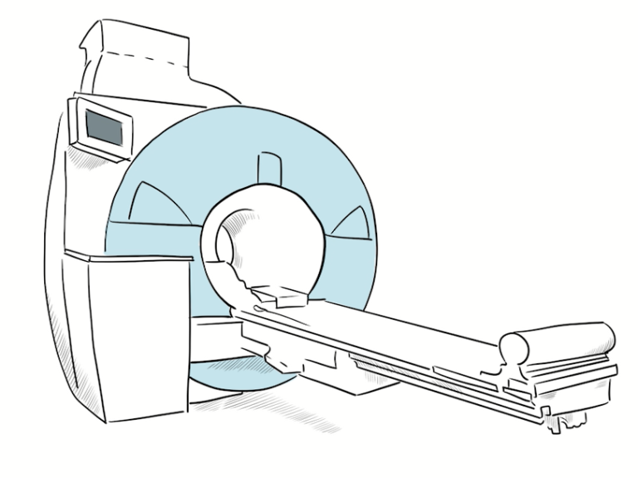
Why do we want to understand the brain?
How can we understand the brain?
What do we know about the brain?

Slide 4
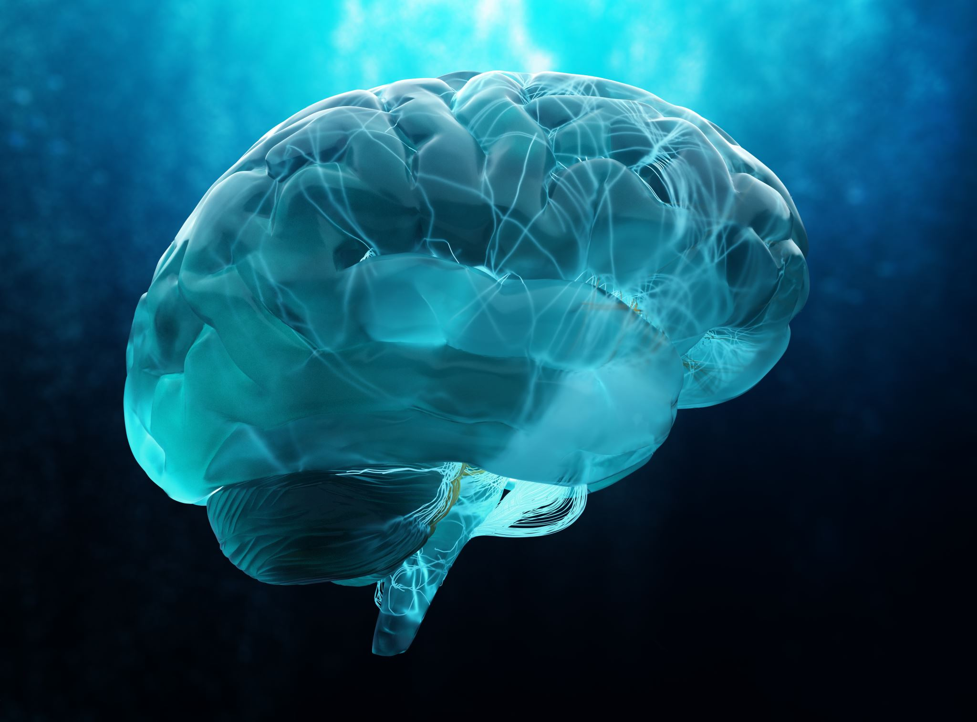
What are the different things that the brain is responsible for?

Slide 5
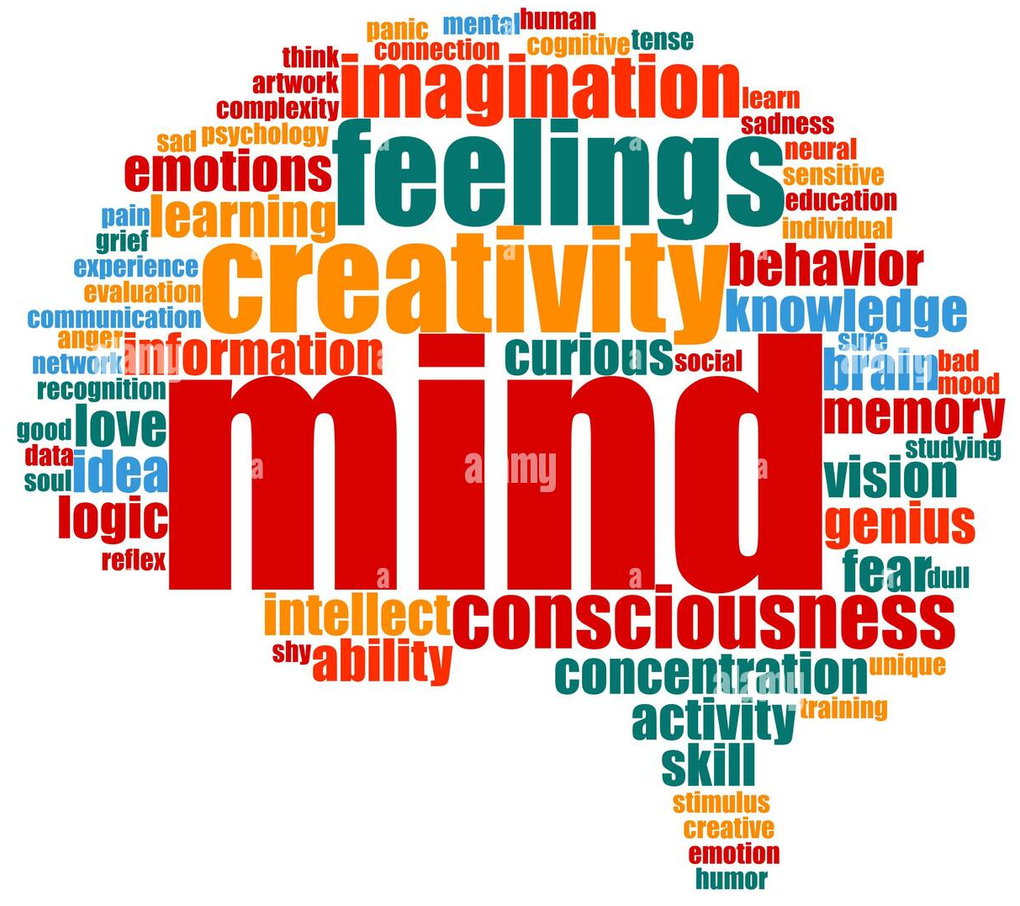

Slide 6




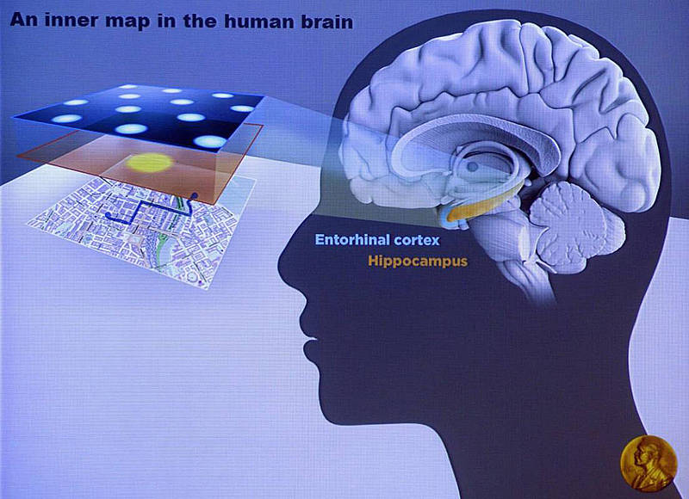
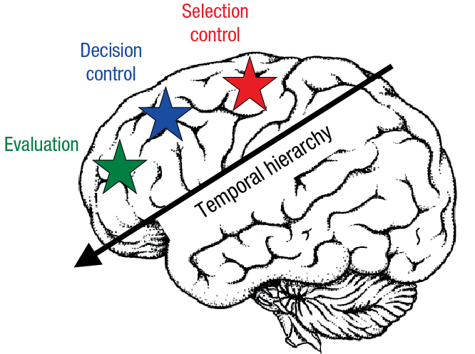
Task
Behaviour
Cause

Slide 7
A few examples of why the brain is so interesting

Slide 8

Simons, 1999

Slide 9

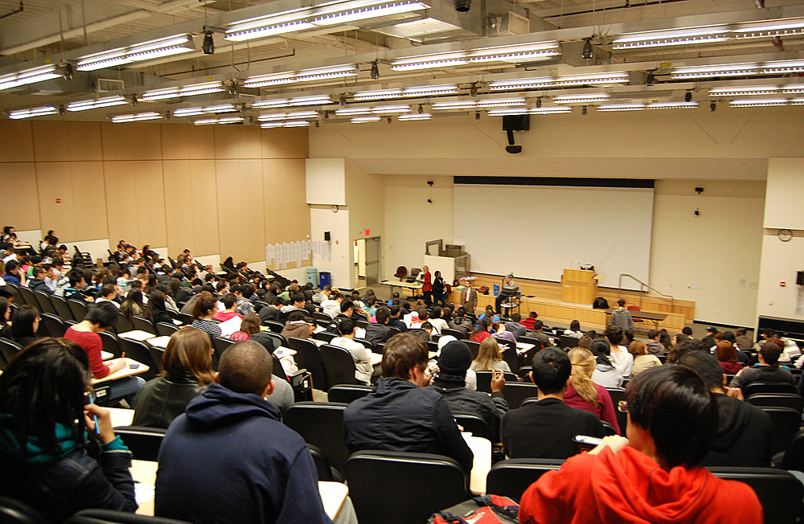
Selective attention

Slide 10
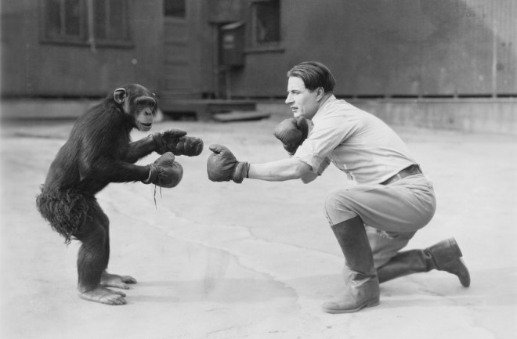
Humans vs chimps
https://humanbenchmark.com/tests/chimp

Slide 11
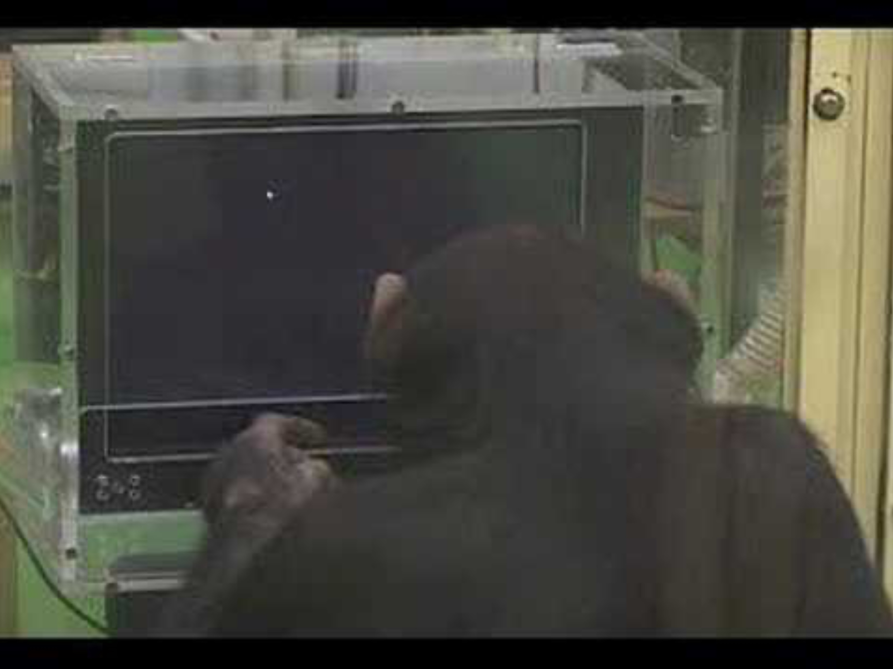
Inoue & Matsuzawa, 2007

Slide 12
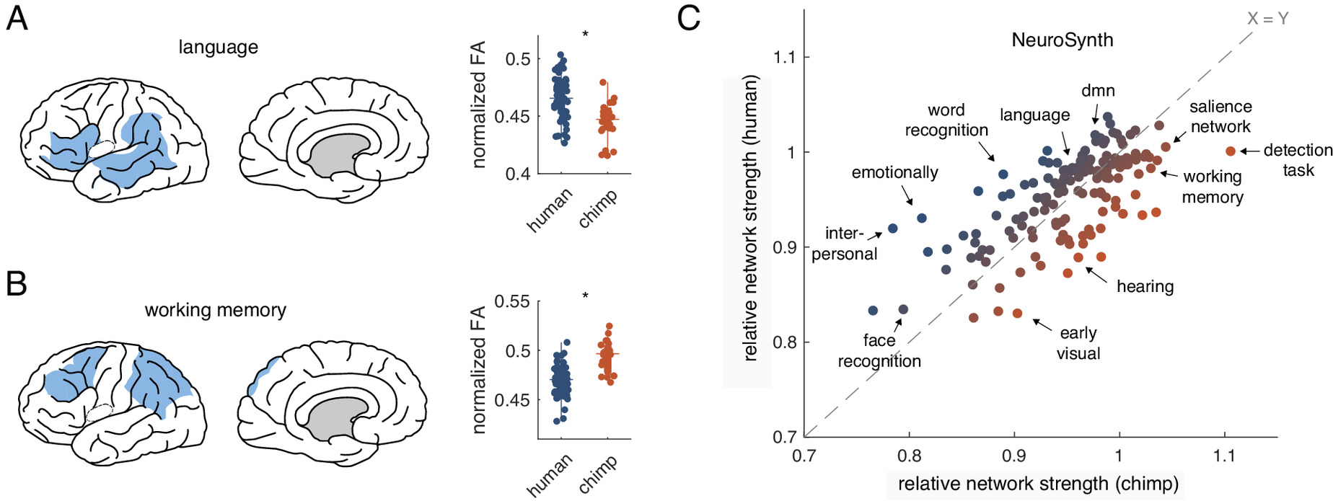
Van Den Heuvel et al., 2023

Slide 13
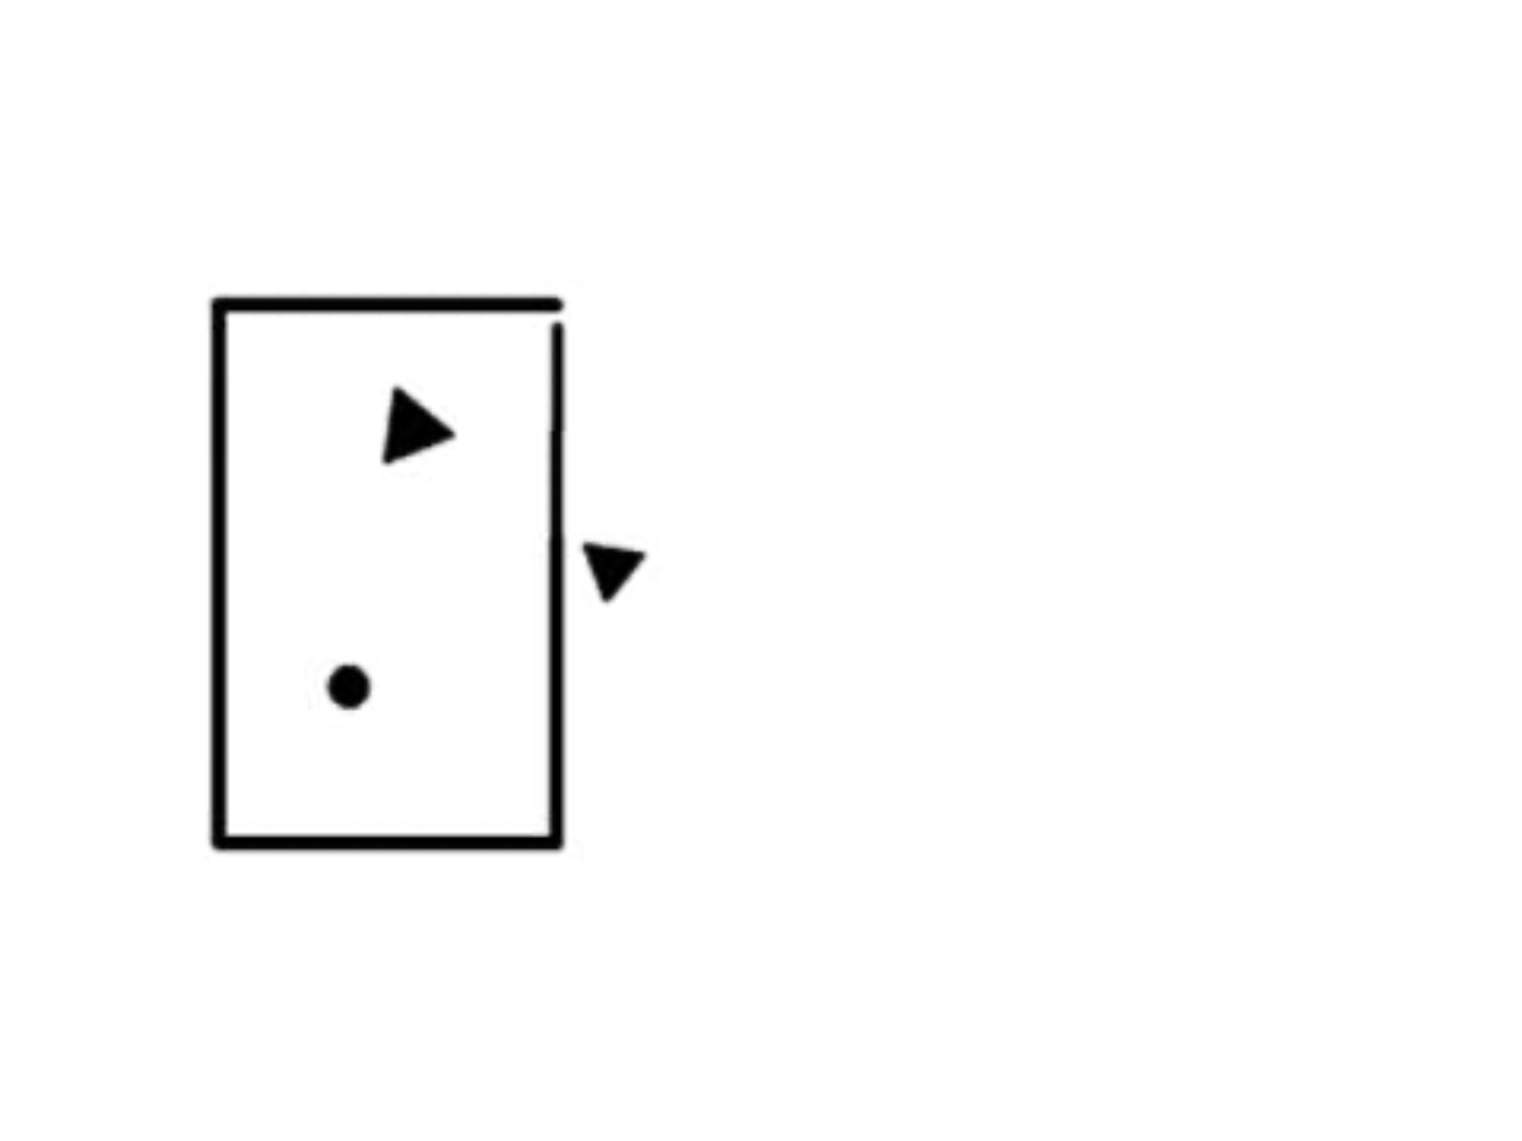

Slide 14


The Heider-Simmel animation (1944)

Slide 15
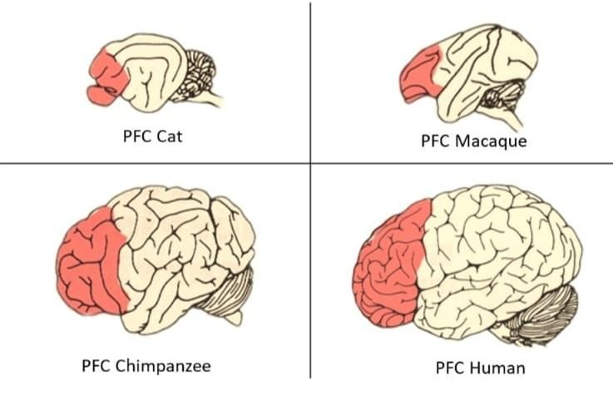
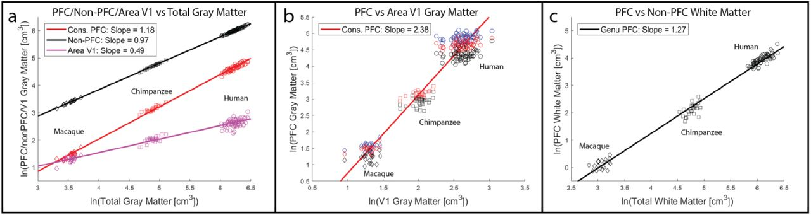
The prefrontal cortex
Valencia-Ortiz et al., 2020
Donahue et al., 2018

Slide 16
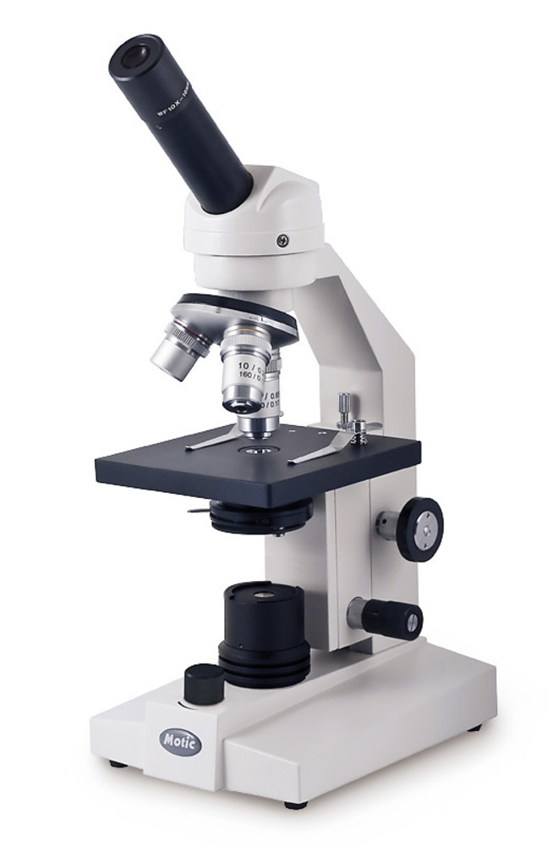
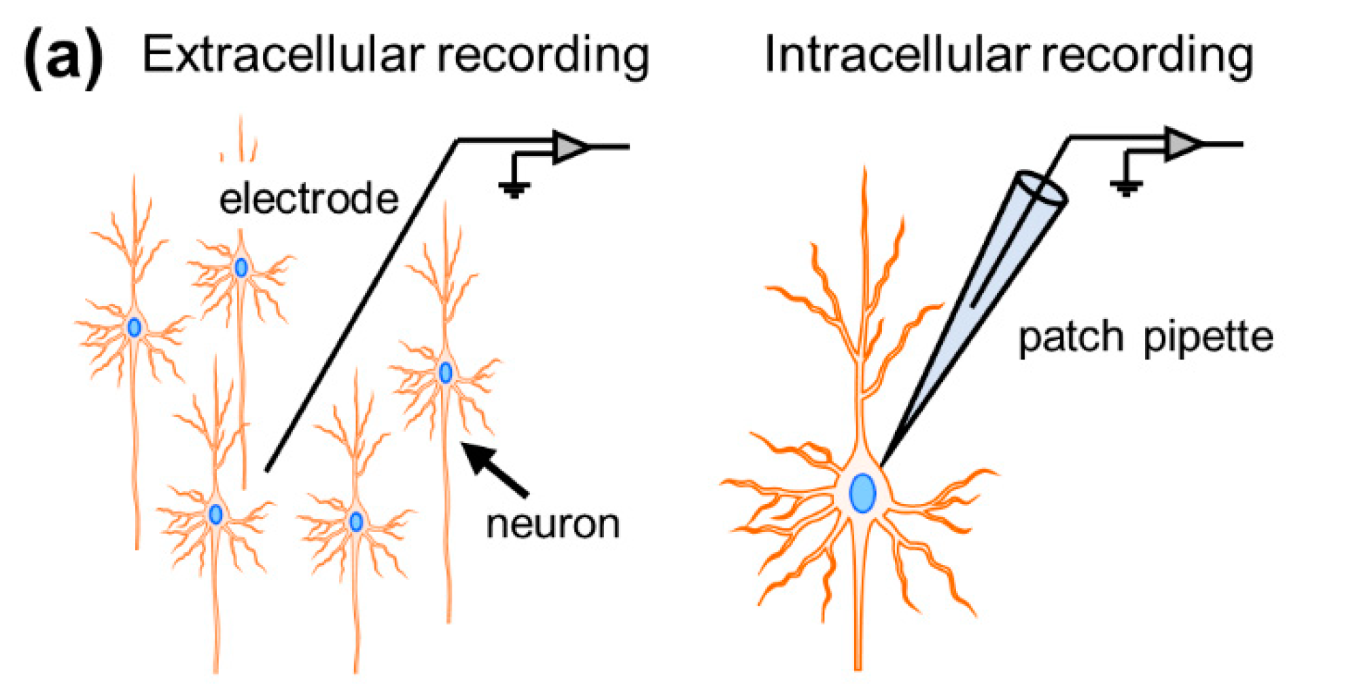
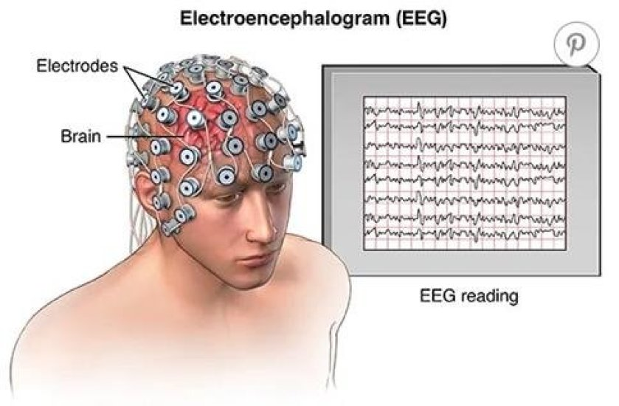
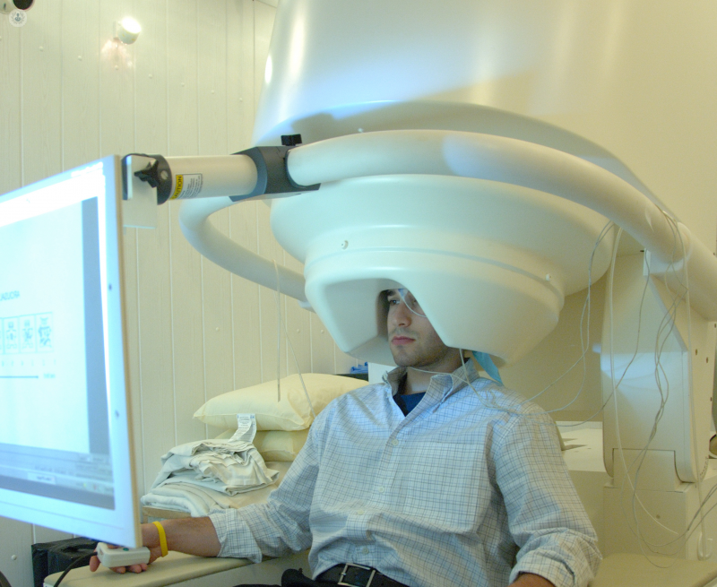
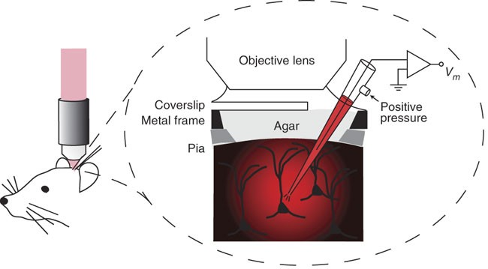
How can we understand the brain?
Micro
Macro
Kitamura et al., 2008; Noguchi et al., 2021

Slide 17
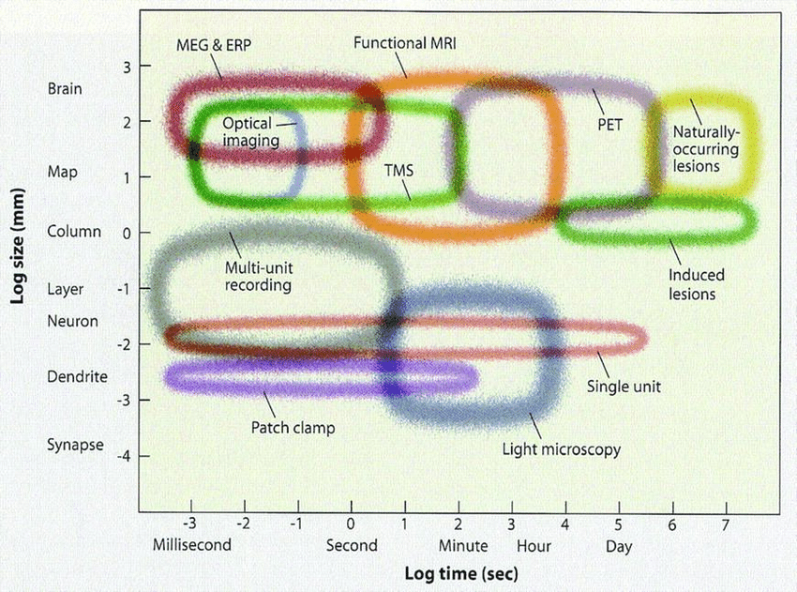
How can we understand the brain?
Sarraf & Sun, 2016

Slide 18
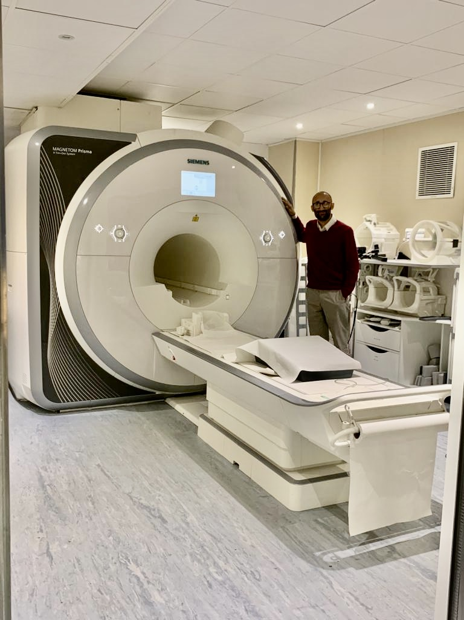
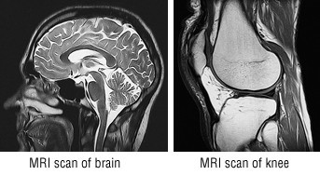
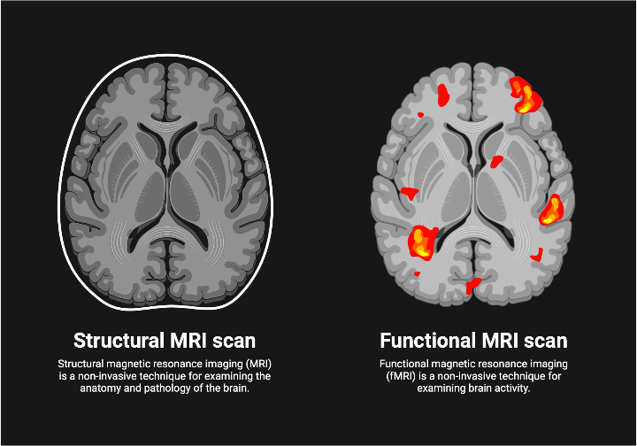
Magnetic
Resonance
Imaging

Slide 19
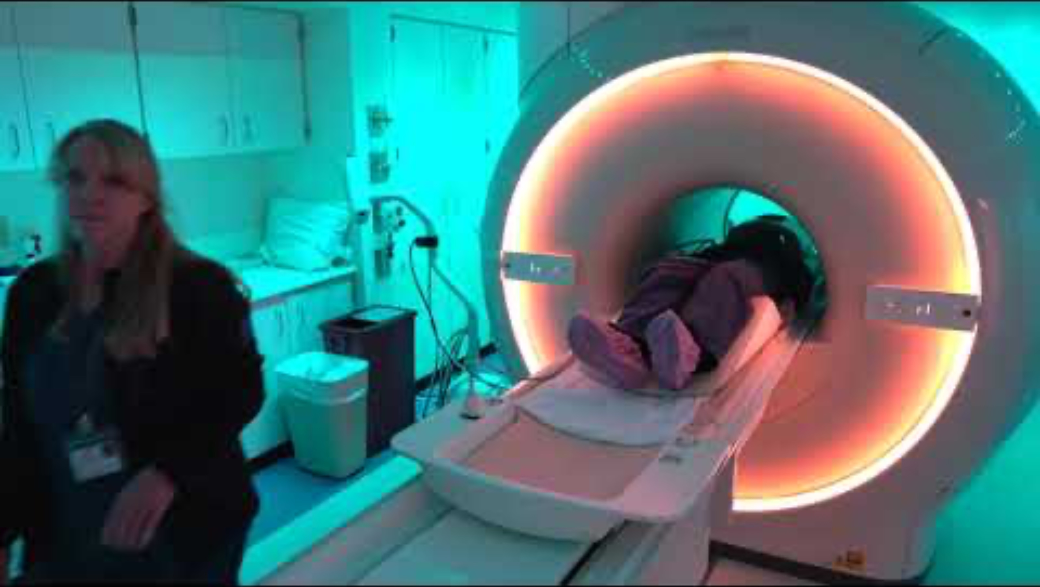

Slide 20
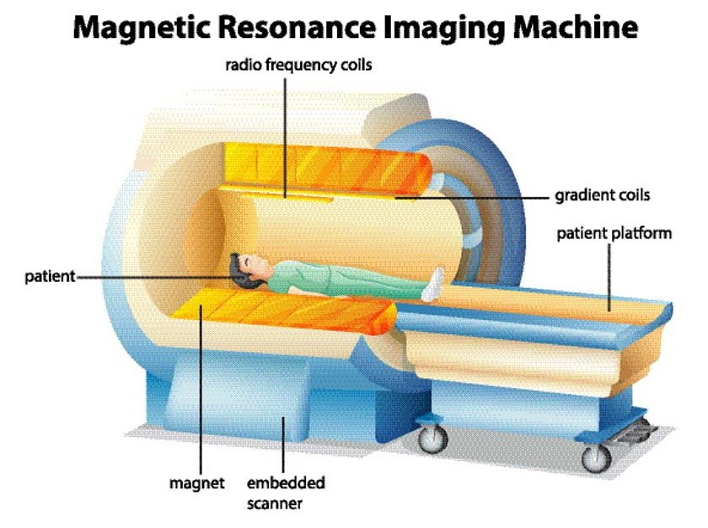
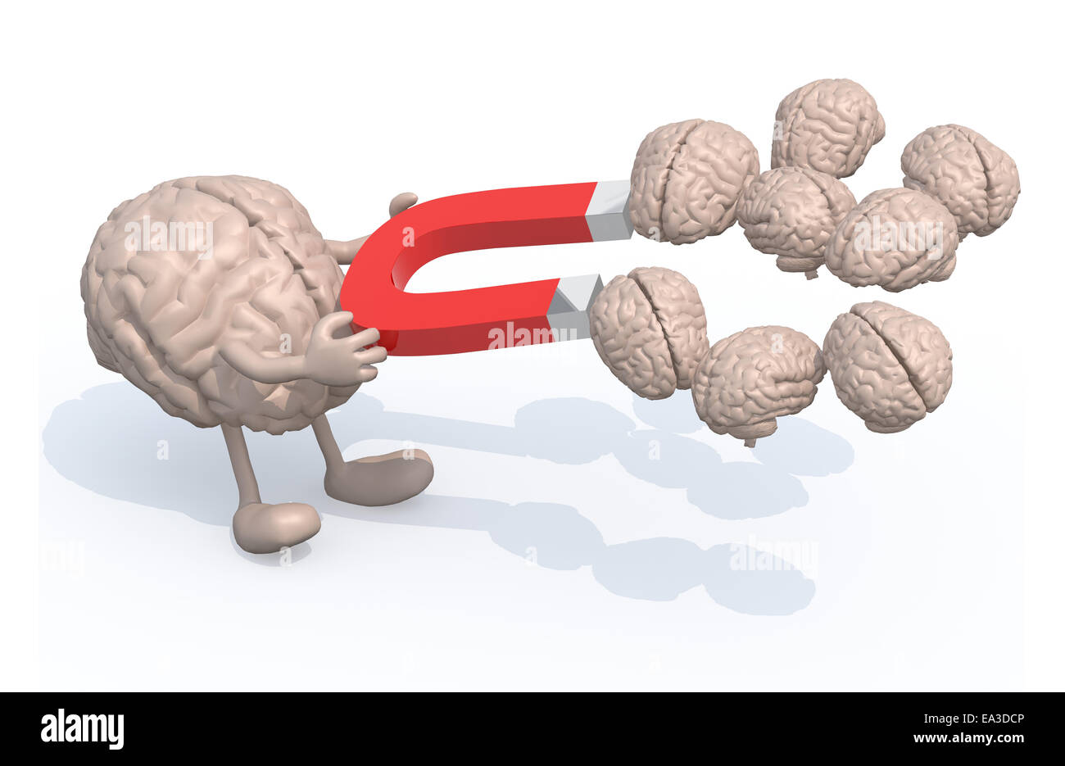
Magnetic Resonance Imaging: how does it work?

Slide 21
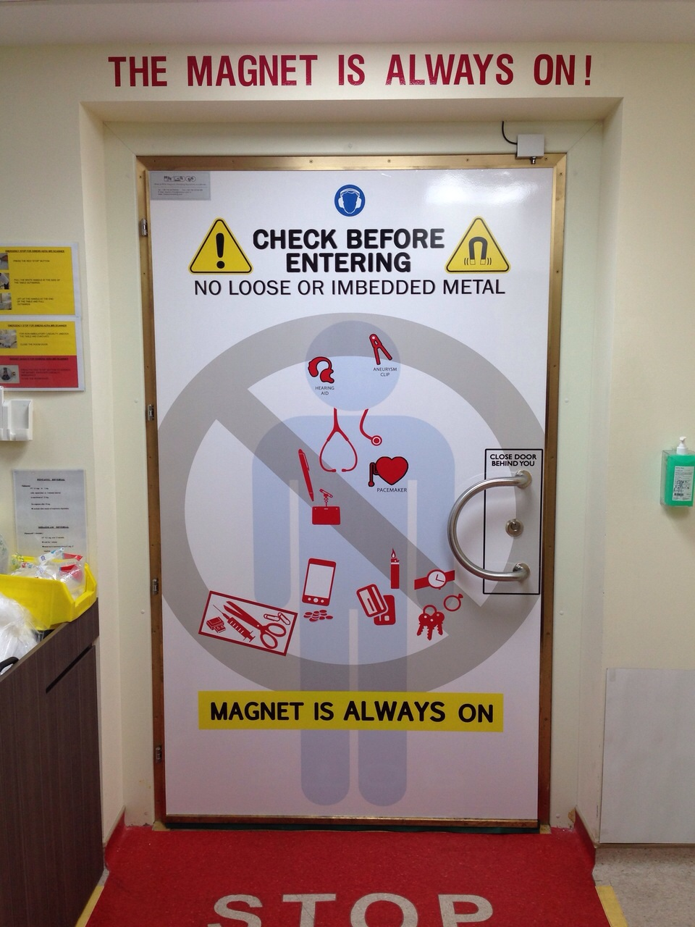
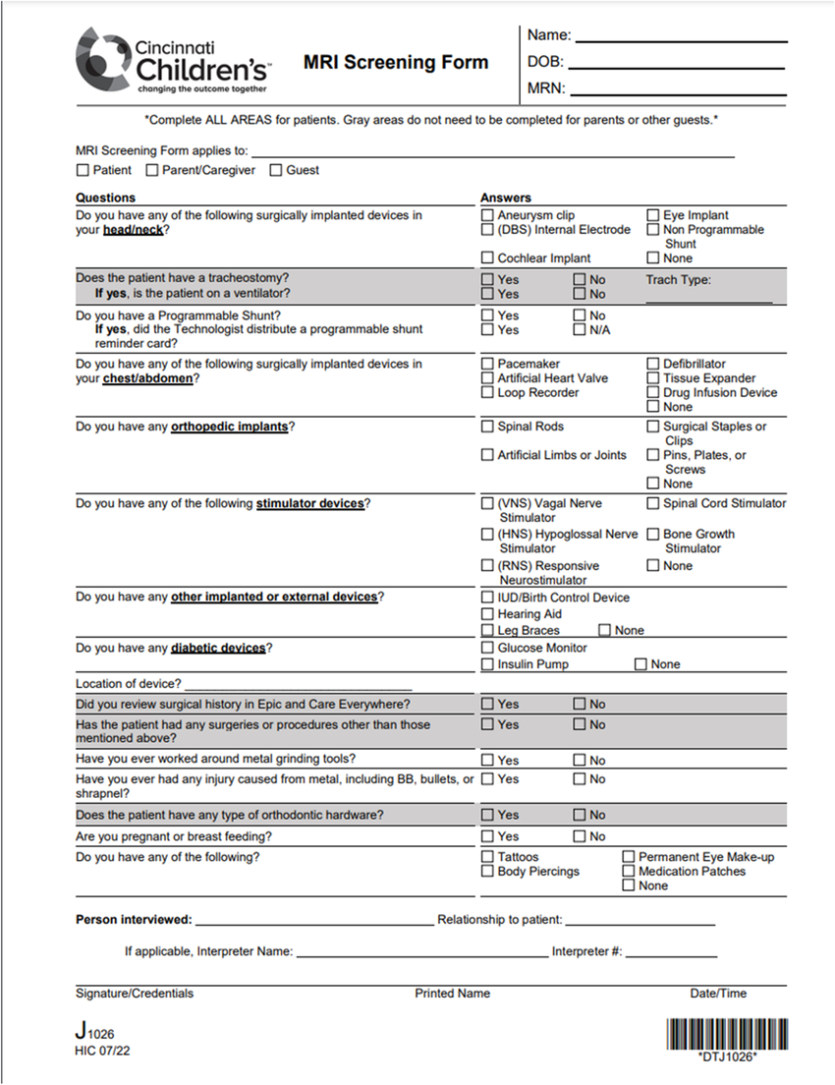
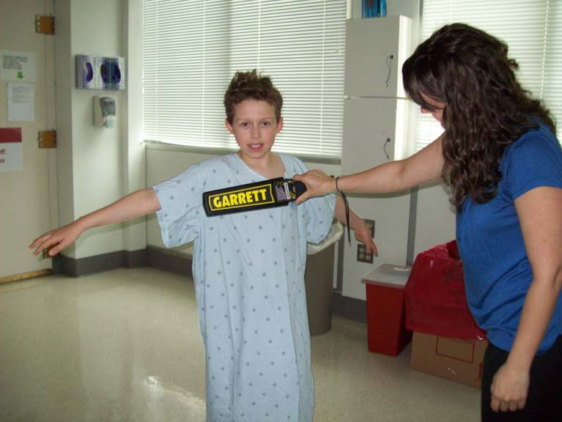
But, this means that we need to extra careful!

Slide 22
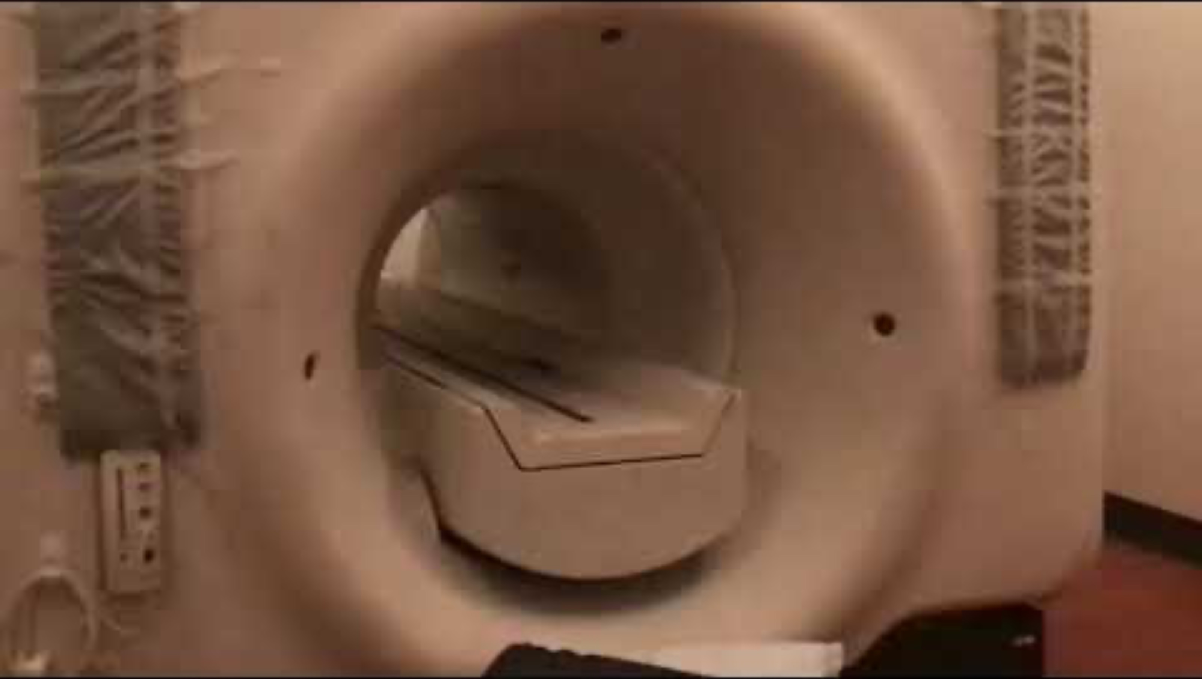

Slide 23
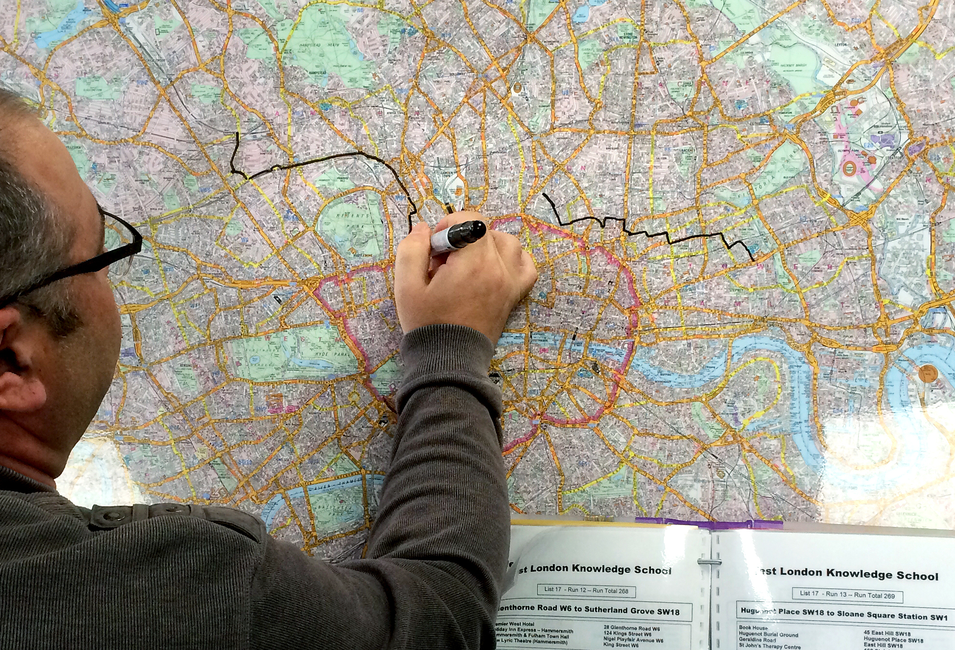
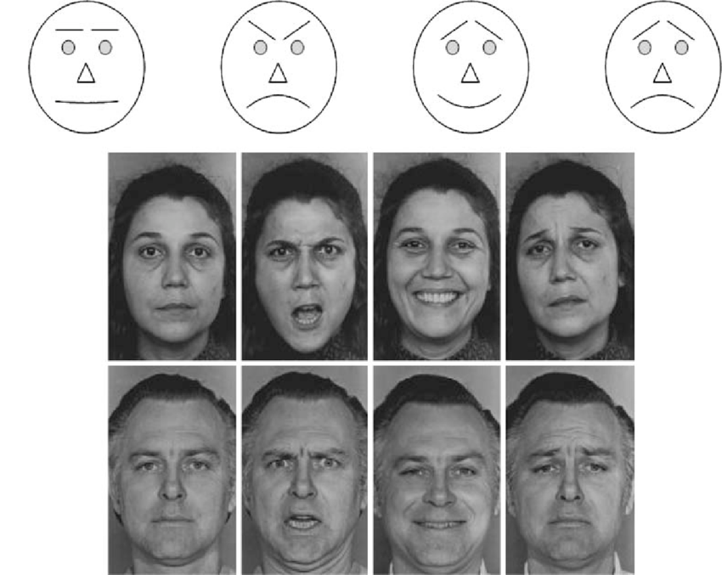

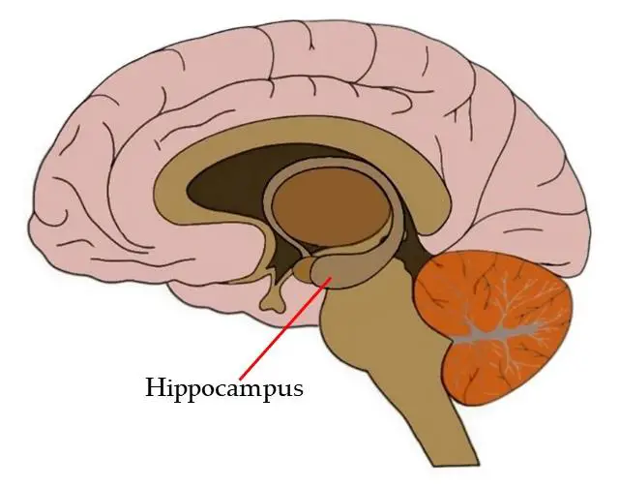
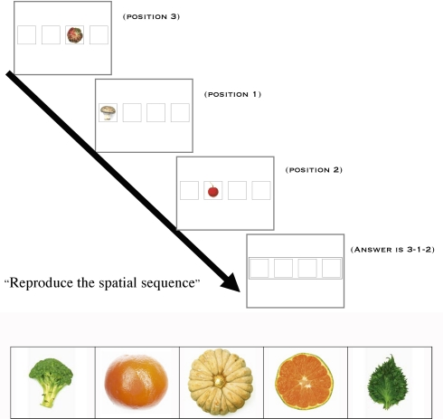
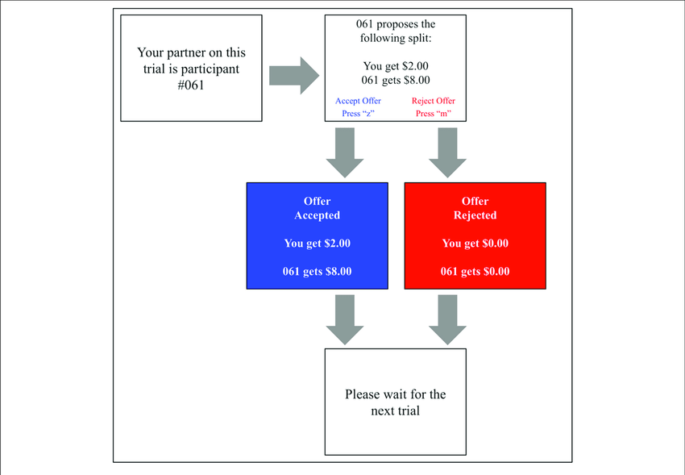
What can we do with MRI?
Emotion
Addiction
Memory
Social
Structural MRI
Functional MRI (activity)

Slide 24



Opportunities at the CHBH

Slide 25


